Slide 1
Peculiarities of precipitating electron spectra : DMPS & ELFIN combined dataset
SPARTHB Zijin Zhang Anton V. Artemyev Vassilis Angelopoulos

Slide 2
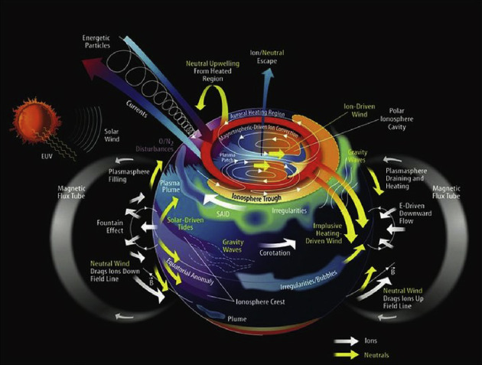
Magnetosphere-ionosphere coupling
Energetic electron precipitation (EEP)
couples the magnetosphere and ionosphere by creating ionization and controlling high‑latitude conductances.
Characterizing spectral distributions of auroral particles is important

Slide 3
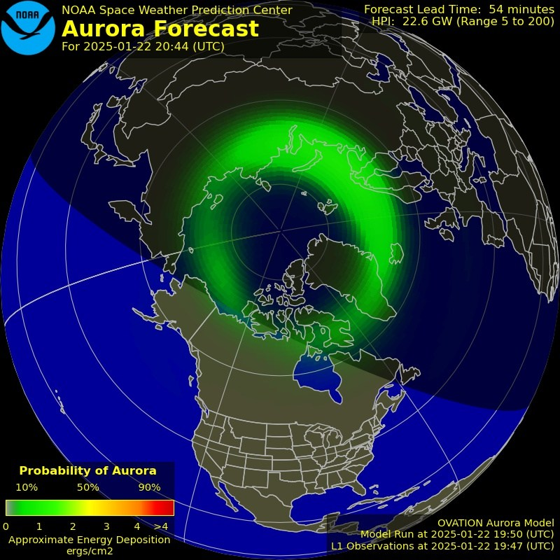
MI modeling
“Large-scale models of the ionosphere [e.g., Quegan et al., 1981; Schunk and Szuszczewicz, 1988; Daniell et al., 1995] require accurate specification of the ionization due to auroral particles, while global thermospheric models [e.g., Roble et al., 1982; Fuller-Rowell et al., 1984; Roble and Ridley, 1994; Ridley et al., 2006; Deng et al., 2013] depend heavily on knowledge of the ionospheric conductivity for calculations of the neutral atmosphere response to ion drag and Joule heating.”
Empirical ionization and conductance models
(like Ovation Prime) often rely on Defense Meteorological Satellite Program (DMSP)
particle spectra as input.

Slide 4
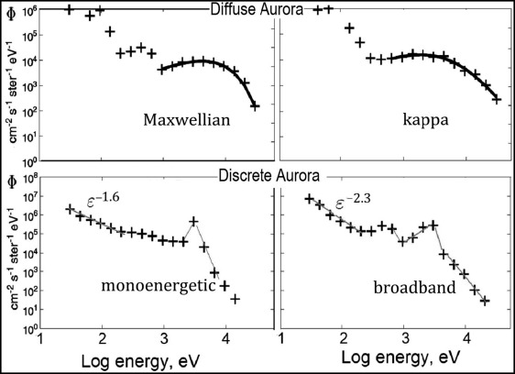
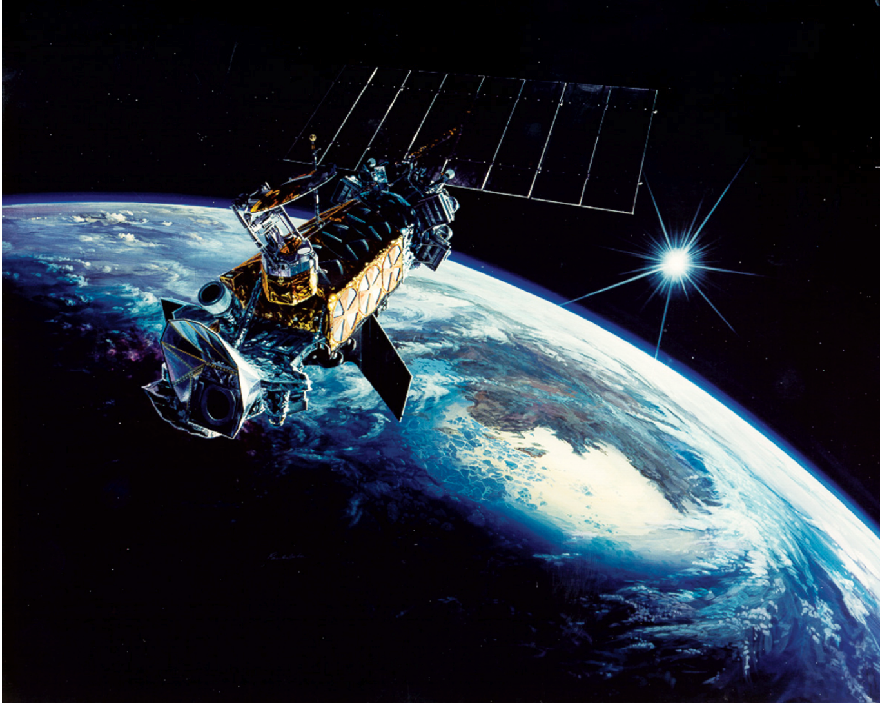
MI modeling
SSJ/4 particle detector [Hardy et al., 1984] measures the flux of precipitating ions and electrons from 30 eV to 30 keV.
“ The remaining limitations to OP-2013 include a limitation to 30 keV (extrapolated to about 50 keV)… the deeper penetration into the atmosphere of high energy particles has important consequences for upper atmosphere chemistry.
More detailed spectral information would also be quite useful for many modeling purposes.”
Examples of DMSP spectra in (top) diffuse and (bottom) discrete aurorae.

Slide 5

Motivation
This work combines ELFIN precipitating electron measurements with DMSP spectra at close conjunction to extend the DMSP‑based precipitation picture toward higher energies (60 keV to 6000 keV).
The goal is an empirical description of spectral parameters and integrated fluxes across MLT/MLAT and geomagnetic activity.
(Differential) Flux as a function of (Energy; MLAT, MLT, AE)
Notes:
Substorm‑time injections and scattering in the plasma sheet drive strong, structured precipitation that imprints on magnetic latitude (MLAT) and magnetic local time (MLT) patterns.

Slide 6
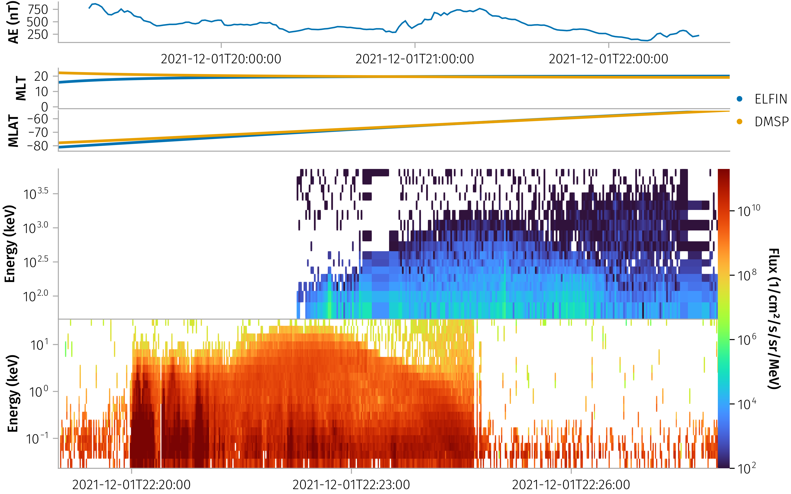
Data and Methods
Categorized into three AE ranges: [0,100], [100,300], and [300,1600] nT.
Conjunction selection
We first identify continuous ELFIN intervals and, for each, search DMSP satellites 16:18 for spatial match. Matching proceeds in MLAT bins of 0.5°; within overlaps we require the mean MLT difference to be < 1 hour.

Slide 7
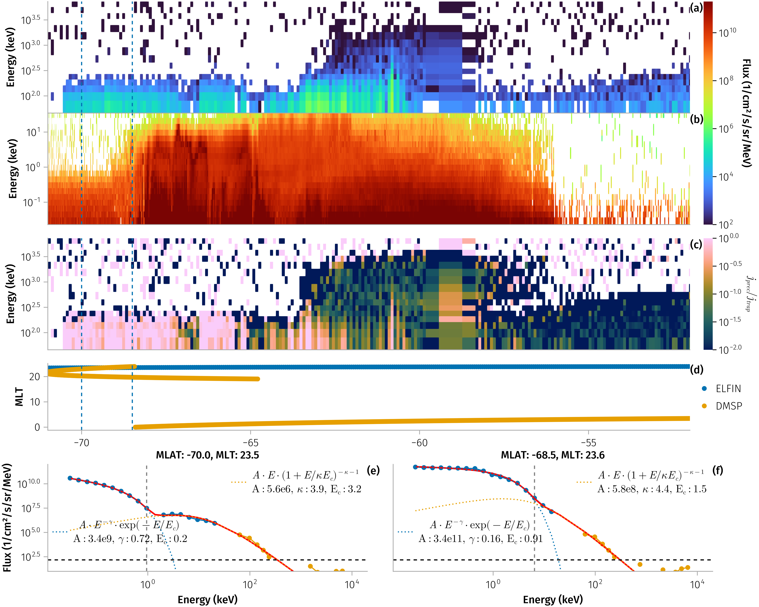
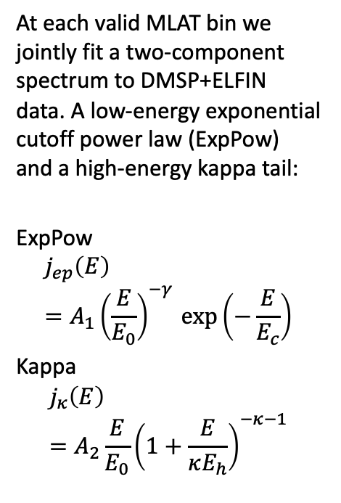
Spectral modeling
Data and Methods
At each valid MLAT bin we jointly fit a two‑component spectrum to DMSP+ELFIN data. A low‑energy exponential cutoff power law (ExpPow) and a high‑energy kappa tail:
ExpPow
$$j_{ep}\left(E\right)=A_{1}{\left(\frac{E}{E_{0}}\right)}^{−γ} exp\left(−\frac{E}{E_{c}}\right)$$
Kappa
$$j_{κ}\left(E\right) \\ =A_{2}\frac{E}{E_{0}}{\left(1+\frac{E}{κE_{h}}\right)}^{−κ−1}$$
Mechanism classification
Using ELFIN spin‑resolved fluxes we form the ratio R = |j_para − j_anti|/j_perp to diagnose scattering. We classify each ELFIN MLAT bin as dominated by whistler‑mode waves or by field‑line curvature scattering (FLCS)

Slide 8
Nonlinear fitting of two models is tricky
Data and Methods
Good example close in MLT and Time
Example with not enough data points
Mechanism classification
Using ELFIN spin‑resolved fluxes we form the ratio R = |j_para − j_anti|/j_perp to diagnose scattering. We classify each ELFIN MLAT bin as dominated by whistler‑mode waves or by field‑line curvature scattering (FLCS)
Example with parameters changing rapidly over MLAT

Slide 9
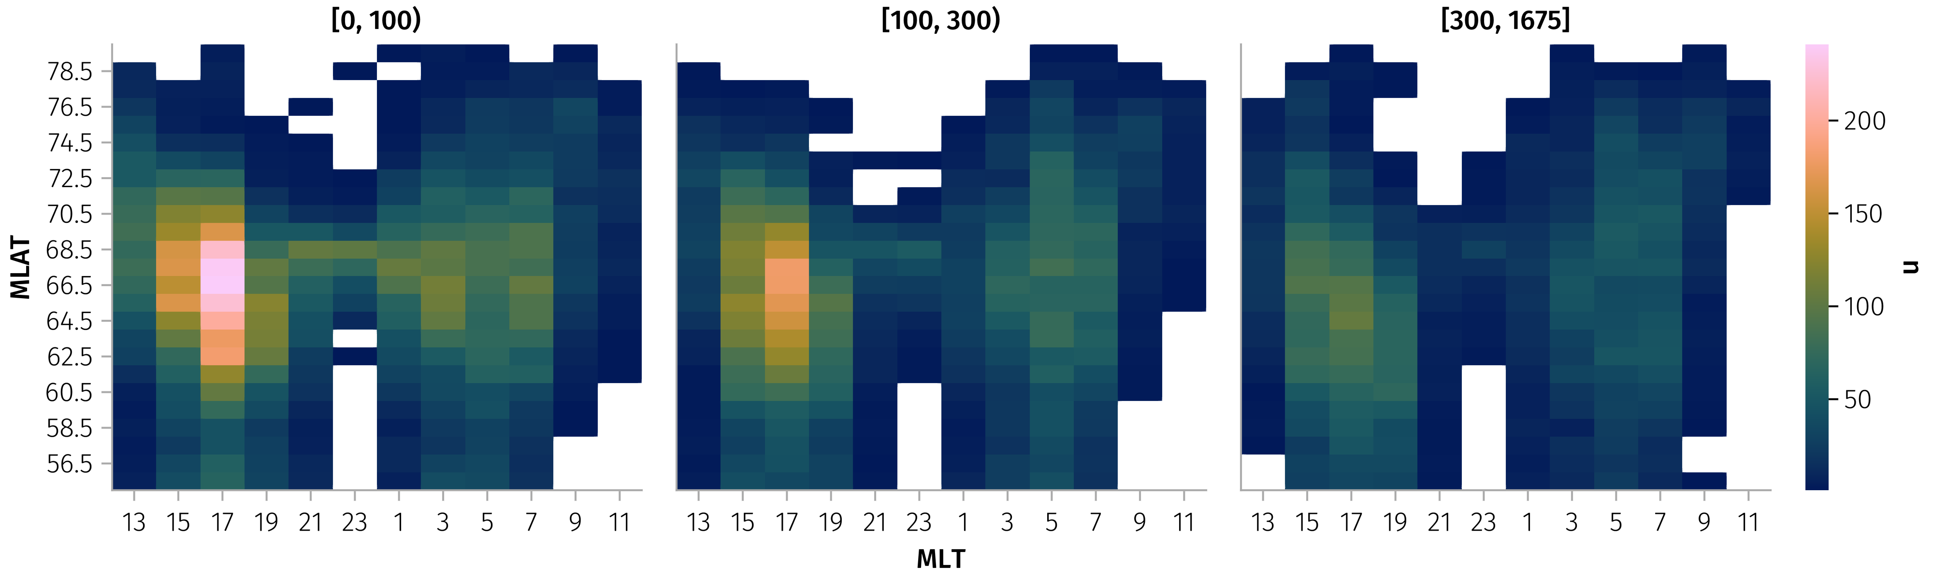
Results
~35000 spectra fitting by MLT/MLAT and AE:

Slide 10
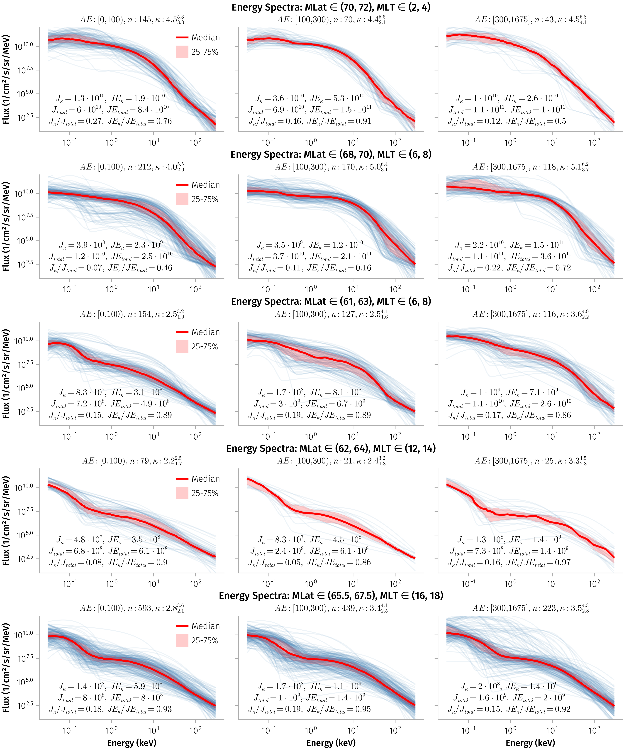
Post-midnight plasma sheet
Energy (keV)
Two component population with clear separation of thermal (plasma sheet) electrons (<10keV) and power-law tail of energetic population, J~E^{-4.5}
Contribution of energetic particles into the total energy flux (JE_{κ}/JE_{total}) increases with AE* increasing from <100nT to [100,300] nT (Too small statistics for AE*>300nT)

Slide 11
Dawn-side plasma sheet
Two component population with clear separation of thermal (plasma sheet) electrons (<10keV) and power-law tail of energetic population, J~E^{-4.5}
Contribution of energetic particles into the total energy flux (JE_{κ}/JE_{total}) increases with AE* increasing to *>300nT
First component becomes flatter and |slope|decreases.

Slide 12
Dawn-side outer radiation belt
Two populations of electrons are not well seen in quite time, but more evident during high AE* (maybe due to injection of plasma sheet electrons)
Energetic component has a power law tail with J~ ~E⁻³ (harder than in plasma sheet)
Contribution of energetic particles into the total energy flux (JE_{κ}/JE_{total}) is about ~10-15% (for high AE* when energetic and plasma sheet populations are well separated)

Slide 13
Day-side outer radiation belt
Thermal electron population has quite small energies (<1keV), whereas the energetic population contribute to more than 50% of energetic fluxes (JE_{κ}/JE_{total})
Energetic component has a power law tail with J~E⁻³ (harder than in plasma sheet)
Contribution of energetic particles into the total energy flux (JE_{κ}/JE_{total}) increases to ~100% for high AE*>300

Slide 14
Pre-midnight plasma sheet/outer radiation belt transition region
Thermal electron population has quite small energies (<1keV), whereas the energetic population contribute to more than 75% of energetic fluxes (JE_{κ}/JE_{total})
Energetic component has a power law tail with J~E⁻⁴ (comparable to the day-side radiation belt)

Slide 15
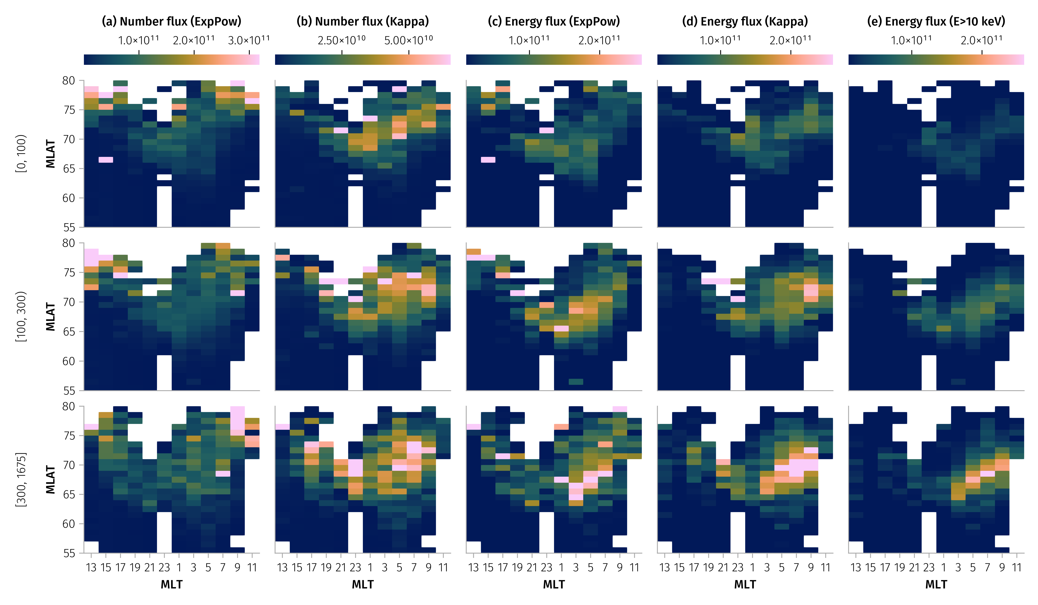
Integrated fluxes
The combined model reproduces coherent spatial patterns that intensify with AE. Columns show number and energy flux from the ExpPow and Kappa components and the total energy flux above 10 keV:

Slide 16
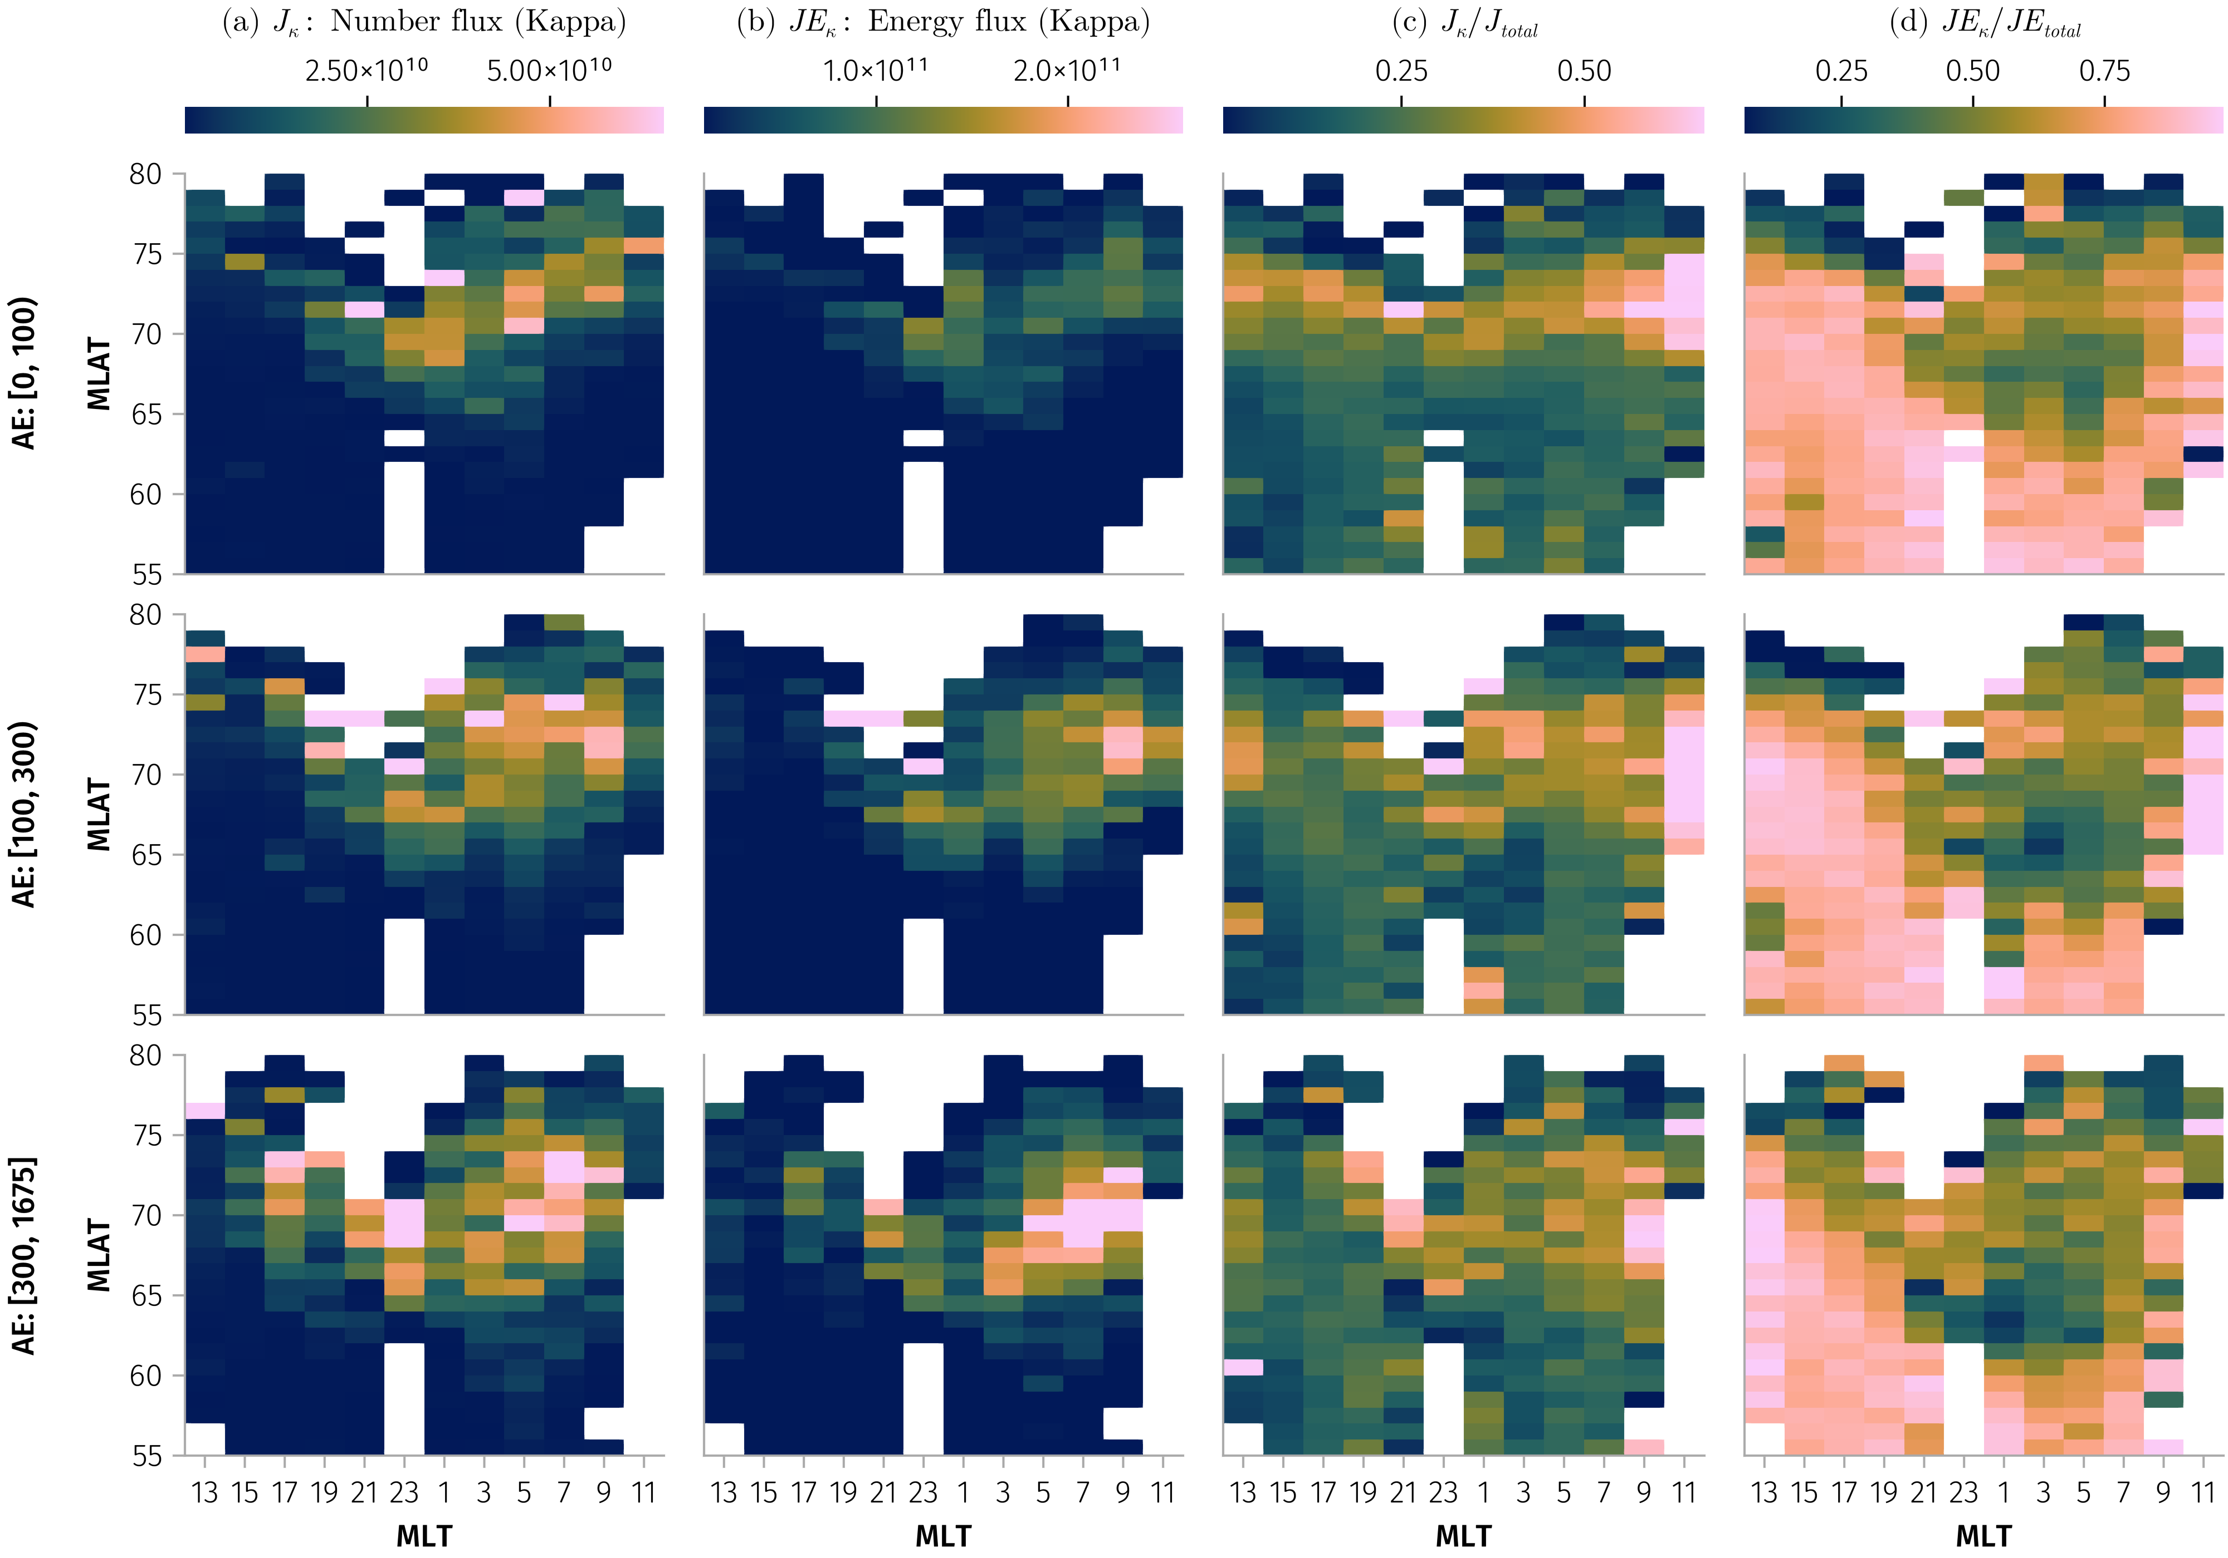
Integrated fluxes
The combined model reproduces coherent spatial patterns that intensify with AE. Columns show number and energy flux from the ExpPow and Kappa components and the total energy flux above 10 keV:

Slide 17
Integrated fluxes
The combined model reproduces coherent spatial patterns that intensify with AE. Rows show AE ranges; columns show number and energy flux from the ExpPow and Kappa components and the total energy flux above 10 keV:

Slide 18
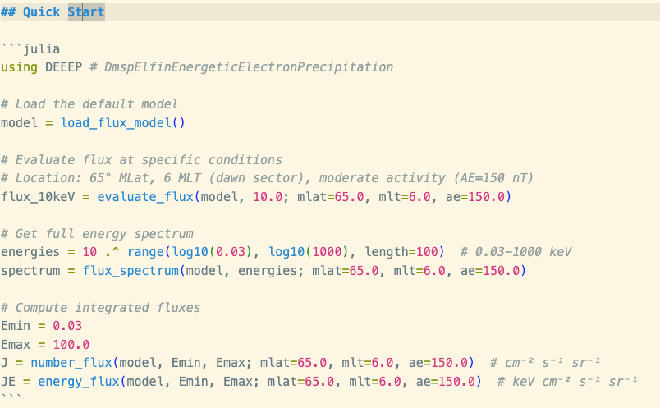
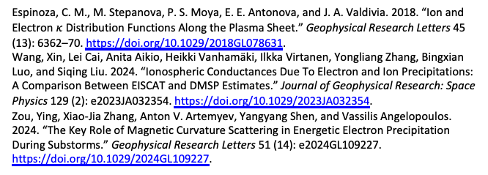
Discussion
The two‑component fit captures a soft low‑energy spectrum with an exponential cutoff and a harder high‑energy tail, enabling integrated flux estimates to 1000~ keV energies while remaining anchored by DMSP at lower energies.
AE‑dependent morphology agrees with the expected night‑side substorm precipitation and supports the use of activity‑conditioned parameterizations.
Espinoza, C. M., M. Stepanova, P. S. Moya, E. E. Antonova, and J. A. Valdivia. 2018. “Ion and Electron $κ$ Distribution Functions Along the Plasma Sheet.” Geophysical Research Letters 45 (13): 6362–70. https://doi.org/10.1029/2018GL078631.
Wang, Xin, Lei Cai, Anita Aikio, Heikki Vanhamäki, Ilkka Virtanen, Yongliang Zhang, Bingxian Luo, and Siqing Liu. 2024. “Ionospheric Conductances Due To Electron and Ion Precipitations: A Comparison Between EISCAT and DMSP Estimates.” Journal of Geophysical Research: Space Physics 129 (2): e2023JA032354. https://doi.org/10.1029/2023JA032354.
Zou, Ying, Xiao-Jia Zhang, Anton V. Artemyev, Yangyang Shen, and Vassilis Angelopoulos. 2024. “The Key Role of Magnetic Curvature Scattering in Energetic Electron Precipitation During Substorms.” Geophysical Research Letters 51 (14): e2024GL109227. https://doi.org/10.1029/2024GL109227.

Slide 19
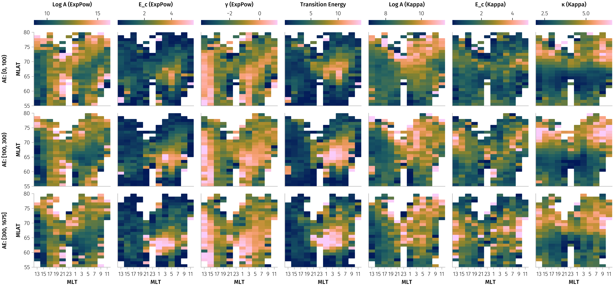
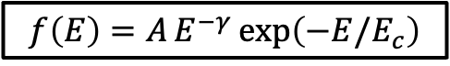
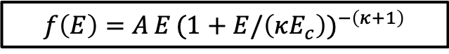
Mean fitted parameters across MLT/MLAT and AE bins:
$$f\left(E\right)=A E^{−γ} exp\left(−E/E_{c}\right)$$
$$f\left(E\right)=A E (1+E/\left(κE_{c}\right))^{−\left(κ+1\right)}$$

Slide 20
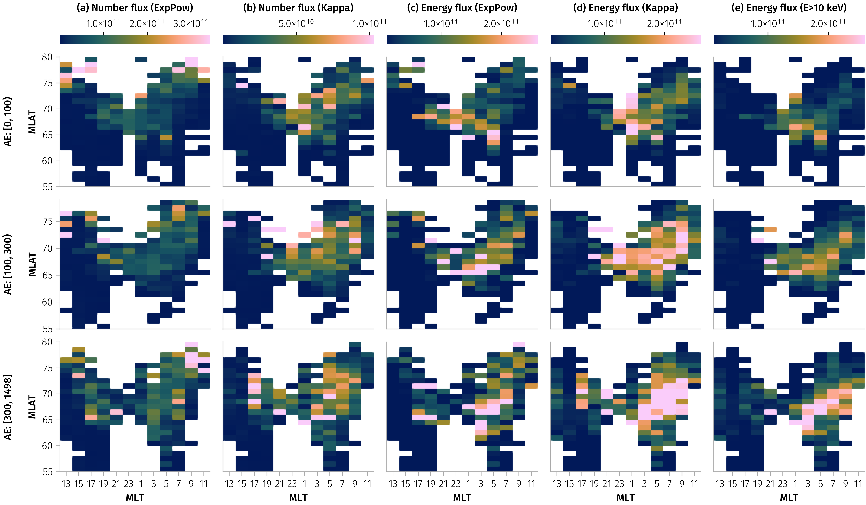
Whistler Wave
Mechanism‑conditioned flux maps
Conditioning on ELFIN‑only mechanism tags clarifies two regimes—whistler‑mode scattering dominating at lower |MLAT| and FLCS dominating poleward:

Slide 21
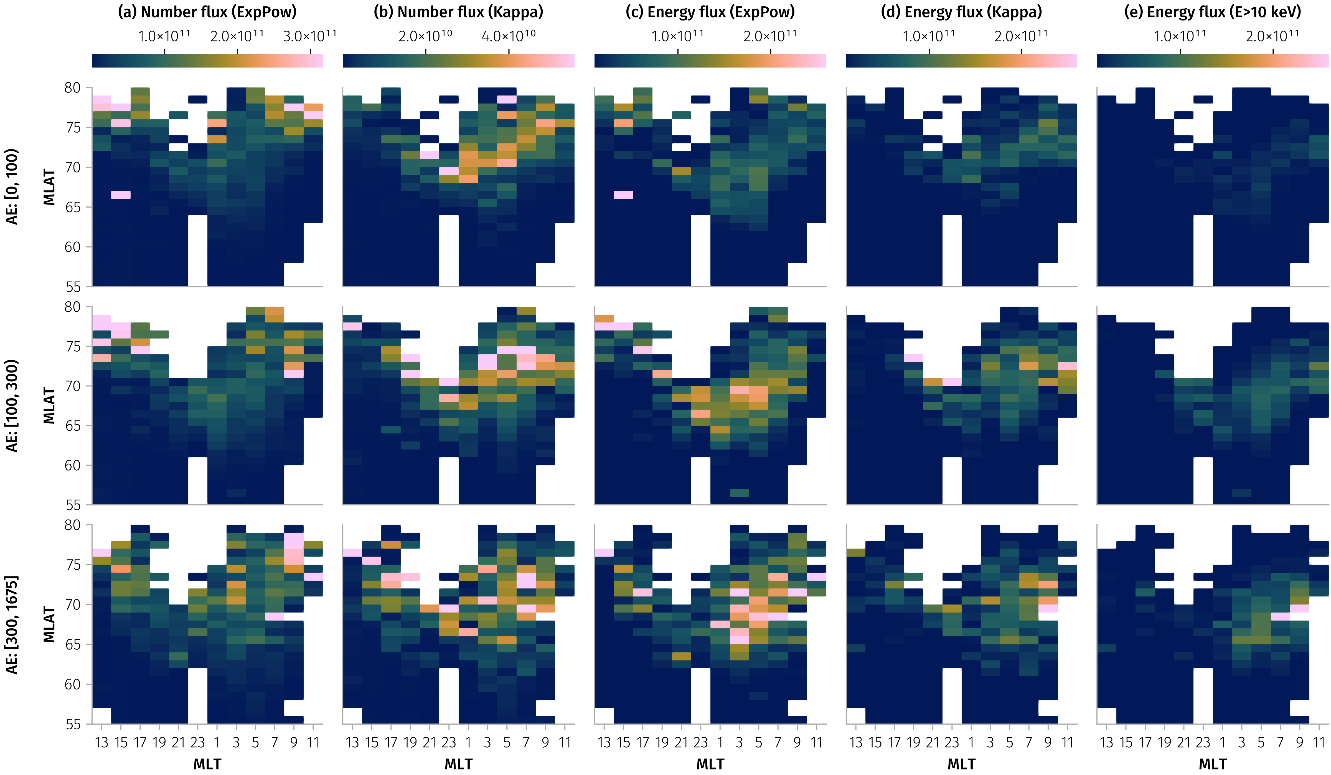
Else

Slide 22
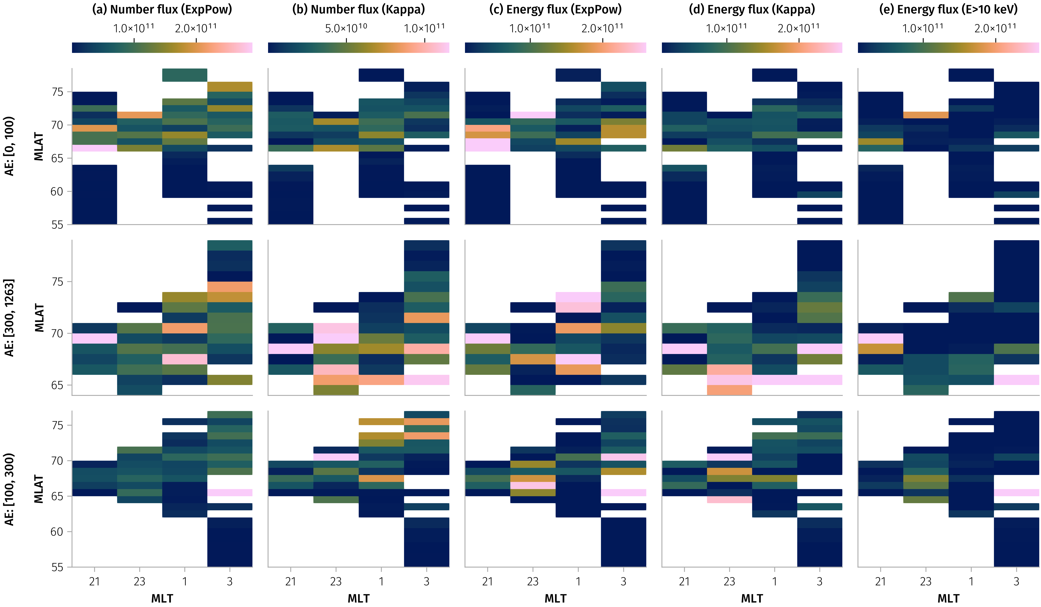
FLCS

